Slide 1
DATA STRUCTURES AND ALGORITHM GROUP 11

Slide 2
OUTLINE
Definition of the problem
Procedure involved
Algorithm Development
Choice of Data Structure
Implementation of Solution
Runtime Analysis
Space Complexity Analysis
Further Improvements

Slide 3

PROBLEM STATEMENT: Develop an algorithm to check if a string is a palindrome
CONSTRAINTS
OBTAIN A STRING FROM STANDARD INPUT
- COULD BE FROM A FILE, OR USER INPUT
OUTPUT
- TRUE OR FALSE
STRING IS READ FROM STANDARD INPUT ONE CHARACTER AT A TIME
-WE ARE UNABLE TO DETERMINE THE EXACT CENTER WHEN WE RECEIVE THE STRING SINCE WE ARE UNSURE OF IT’S LENGTH
COMARE 2 STACKS
- IF WE USE THE STACK IMPLEMENTATION

Slide 4
DATA STRUCTURE: STACKS(Linked list implementation)
MOTIVE:
Size of user input cannot be determined beforehand (we could guess it wouldn’t be a long word but how short?)
ADVANTAGES
Easily resizable (dynamic and fits the problem description)
Constant space and time complexity for all operations
Memory efficient
Easier implementation
DISADVANTAGES
Slight overhead in creating every node
Individual nodes take more space than individual elements in an array implementation(4 bytes more in java)

Slide 5
ALGORITHM
CREATE THREE STACKS
-INPUT
-OUTPUT
-TEMPORARY
PUSH THE INPUT STRING (CHARACTER BY CHARACTER) ONTO THE INPUT AND TEMPORARY STACKS
POP THE TEMPORARY STACK INTO THE OUTPUT STACK(REVERSING ROUTINE)
COMPARE OUTPUT STACK AND INPUT STACK(DECISION ROUTINE)

Slide 6
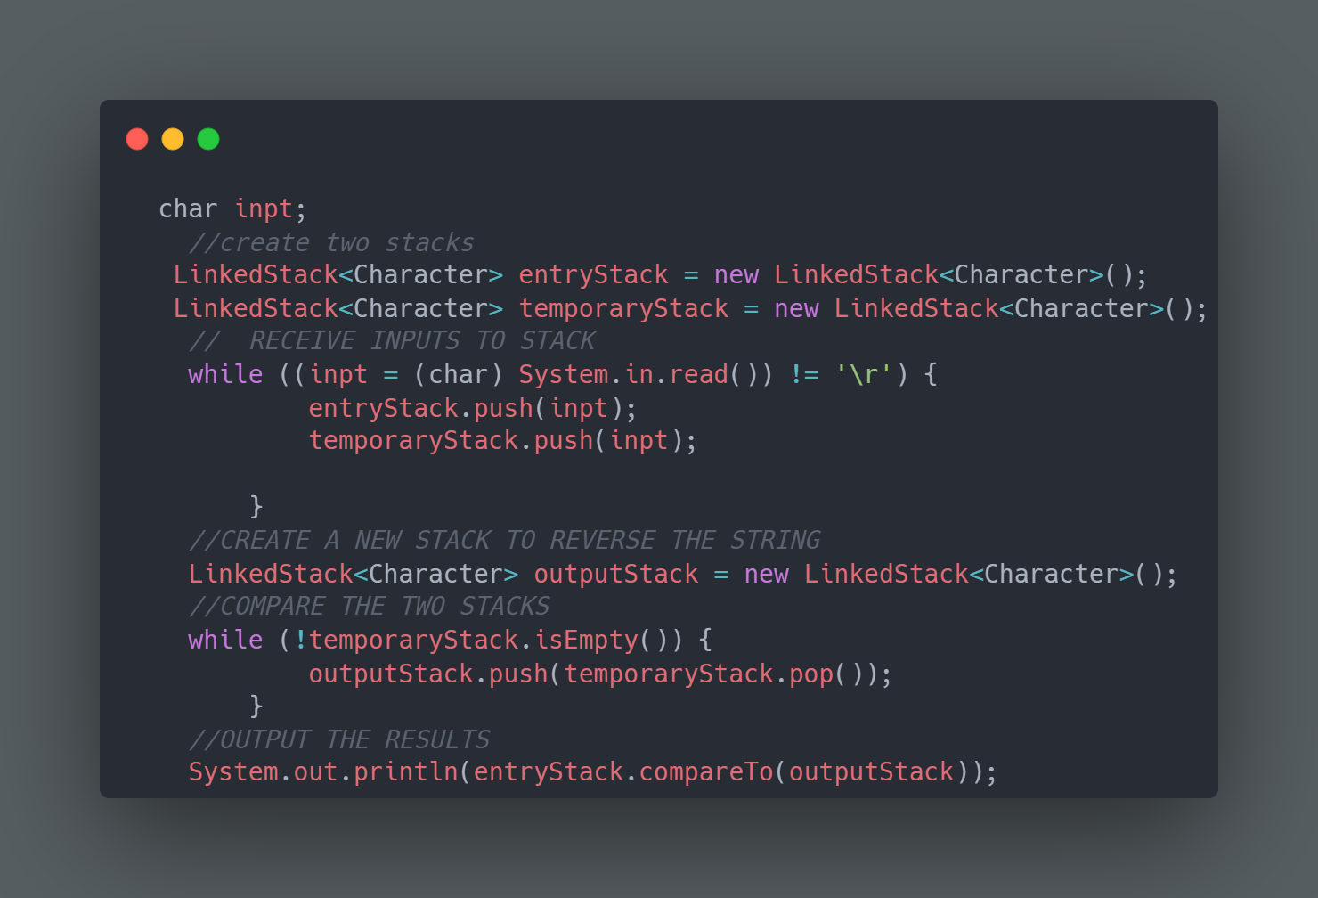
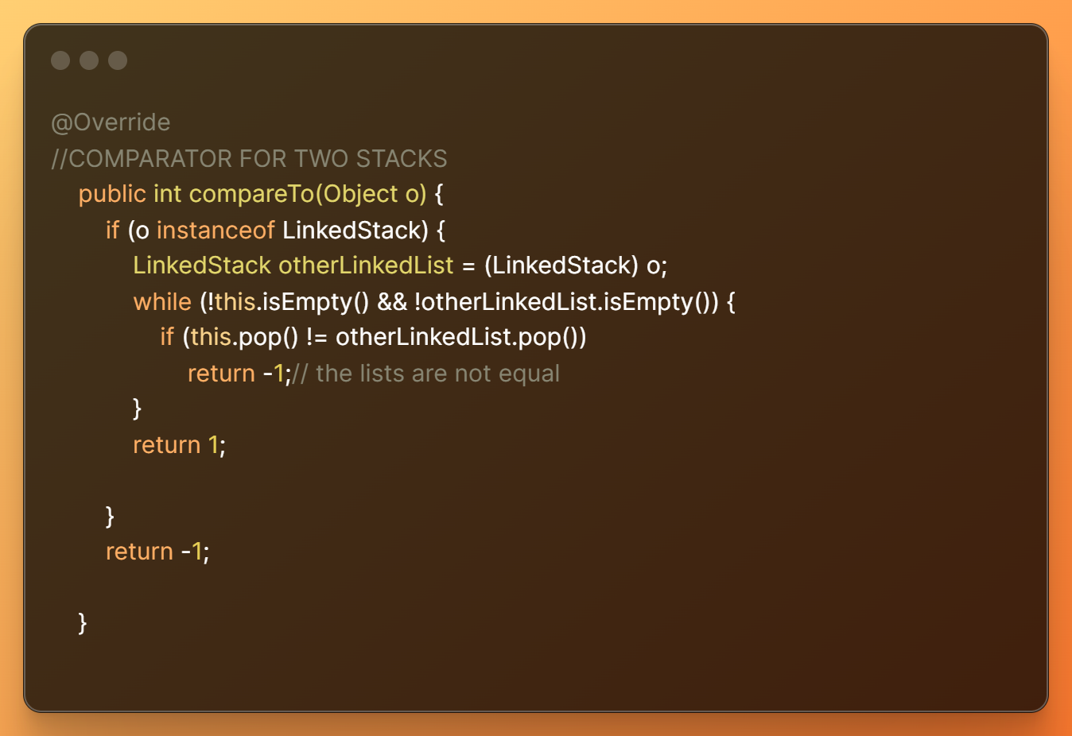
CODE IMPLEMENTATION
ALGORITHM IMPLEMENTATION
COMPARATOR IMPLEMENTATION

Slide 7
INVARIANTS ☹ -constants to maintain the accuracy of the algorithm
INPUT AND OUTPUT STACK SHOULD HAVE THE SAME SIZE
INPUT AND OUTPUT STACK SHOULD CONTAIN THE SAME ELEMENTS (NOT NECESSARILY IN THE SAME ORDER)
OUTPUT STACK SHOULD CONTAIN THE REVERSE OF THE INPUT STACK

Slide 8
RUNTIME ANALYSIS
BEST CASE(O(1)) :
INPUT CONTAINS ONLY A CHARACTER OR NONE
STRING CONTAINS DIFFERENT CHARACTERS AT BOTH END
WORSE CASE(O(N)) :
n CHARACTERS(SAME) IN INPUT AND IT’S LONG eg (“aaaaaa…..aaa”)
AVERAGE CASE (O(N)):
STRING CONTAINS SIMILAR CHARACTERS AT THE END BUT ONLY
DIFFER IN THE MIDDLE

Slide 9
SPACE COMPLEXITY ANALYSIS
WORSE CASE: O(N)
-We reserve space for every stack (3), which approximates O(3n) and is amortized to O(n).
-In comparison to an array, we use more space (i.e., each of our n’s uses more space) as we must store the links to the next elements in a linked-list; however, this comes at a trade off for dynamic memory (which isn’t more efficiently implemented in arrays).
FEATURE | ARRAY STACK IMPLEMENTATION | LINKED LIST STACK IMPLEMENTATION
NODE | SAME AS DATA SIZE | SAME AS DATA SIZE
LINK | ZERO(WE DON’T STORE LINKS IN ARRAY) | 8 BYTES/ 4 BYTES DEPENDING ON (64/32 BITS SYSTEM)
OVERHEAD IN EACH OPERATION | UNEVEN OVERHEAD(CALLS FOR RESIZING SOMETIMES) | CONSTANT OVERHEAD

Slide 10
COULD WE DO BETTER?
To determine a palindrome the string should read same as forward and backward
In essence we must touch every single element of the string
This means the best we could do is O(n) i.e. touching all the elements once(in the average case)
Our algorithm runs in approximately O(n) time hence we can’t do better (at least according to theory and based on the problem constraints)

Slide 11
FURTHER IMPROVEMENT
WE COULD MAKE HALF THE NUMBER OF TOTAL COMPARES
- THIS WOULD NOT MAKE MUCH DIFFERENCE FOR SHORT WORDS BUT WILL BE NOTICABLE IN EXTREME LONG WORDS
(This wasn’t possible because we had to receive input one character at a time)

Slide 12
THANK YOU

